Slide 1
Nearest State/County Finder
Stephanie Cuterez
Nuwapa Promchotichai (Prim)

Slide 2
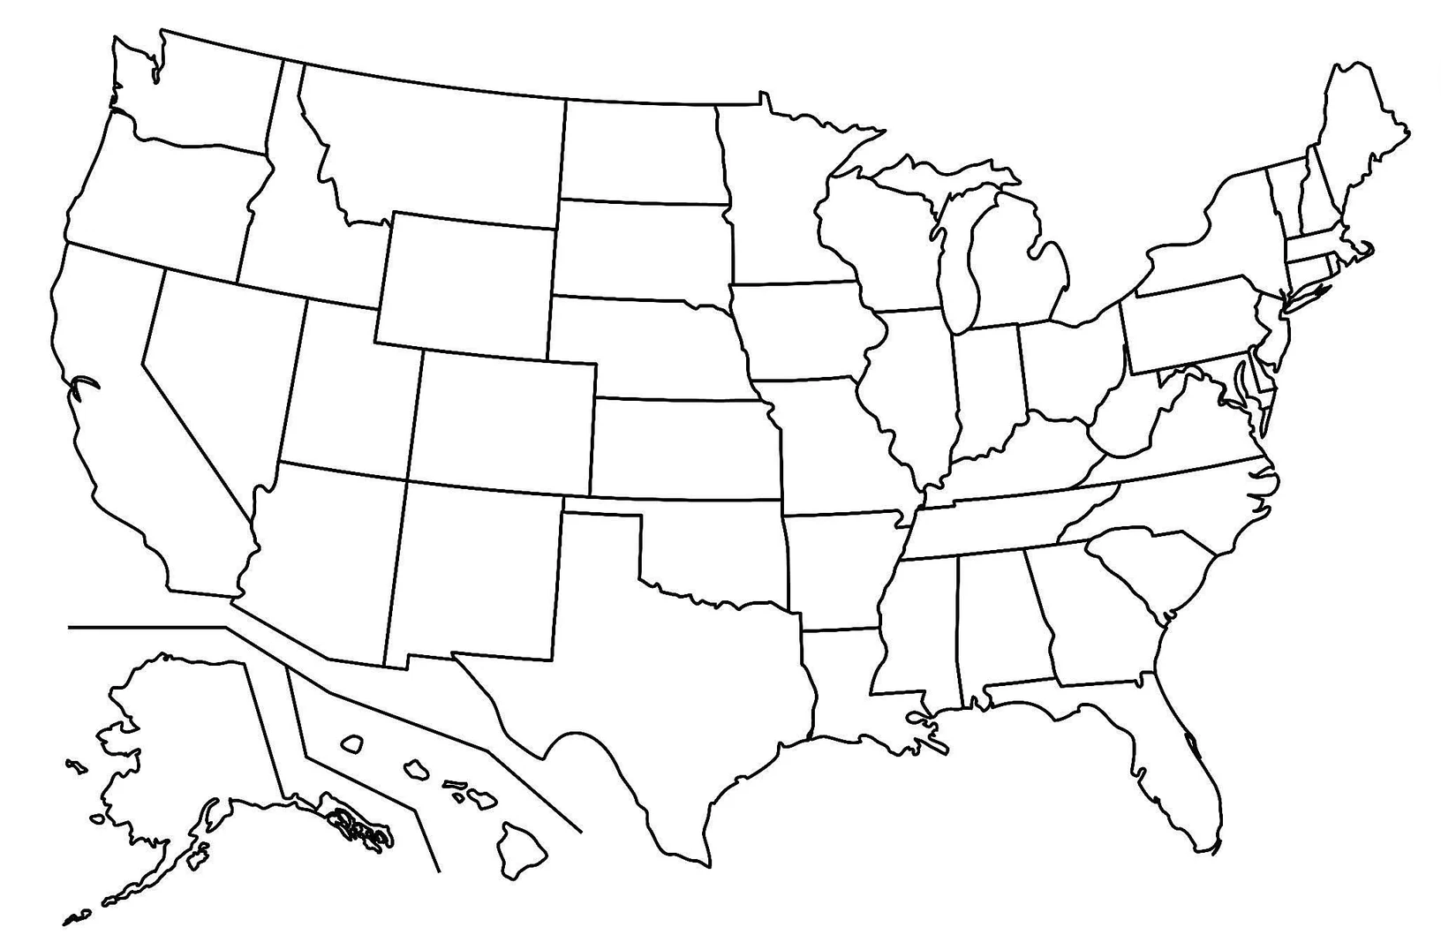
Problem
Given the input of decimal latitude and longitude (i.e. point A),
find the nearest state/county of that point
A

Slide 3
Project Proposal
Dataset: reference points extracted from official US Board on Geographic Names (76.1 MB)
Input: user input of decimal latitude and decimal longitude
Output:
Given the input, return nearest K reference points (K = 1 to 10) from the dataset.
Find the nearest state/county of the input by doing majority voting among the 5 nearest points
STATE_ALPHA COUNTY_NAME PRIM_LAT_DEC PRIM_LONG_DEC
AR Benton 36.4805825 -94.4580681
AZ Apache 36.4611122 -109.4784394
AZ Apache 36.546112 -109.5176069
.
.
.

Slide 4
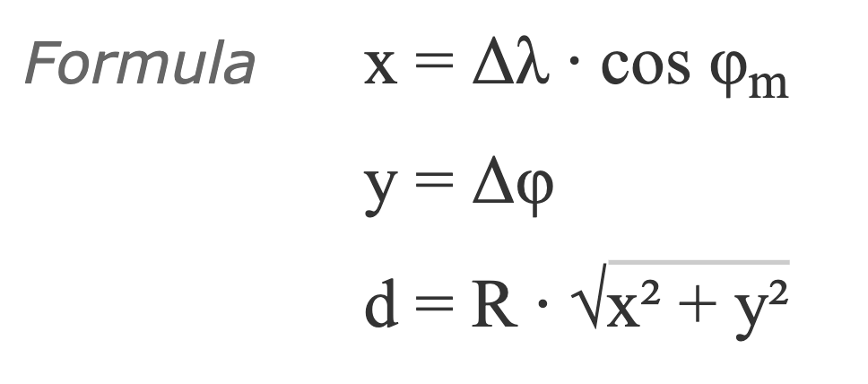
Implementation Details
Programming language: C++
Distance computation: Equirectangular approximation
Test and analyze different data structures to optimize the search for nearest points
where λ is longitude,
𝜑 is latitude
R is Earth’s radius
Notes:
Equirectangular approximation:
suitable for small distances, gives better performance, although less accurate
It basically uses Pythagorean theorem on an equi­rectangular projec­tion

Slide 5
Plans
Phase 1: CLI for user input (latitude, longitude). Loop through all the states/counties inside the dataset, and calculate the distance between points. Output the nearest state and county.
Phase 2: Find data structure for the dataset to make the search operation better than O(n). E.g. look into k-d tree, R-tree. Implement the most efficient data structure.
Phase 3: Develop a GUI to let users pick a point on the USA map and displays the nearest state and county of the picked location.

